Slide 1
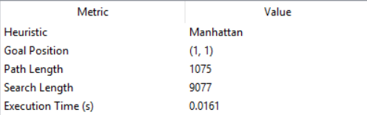
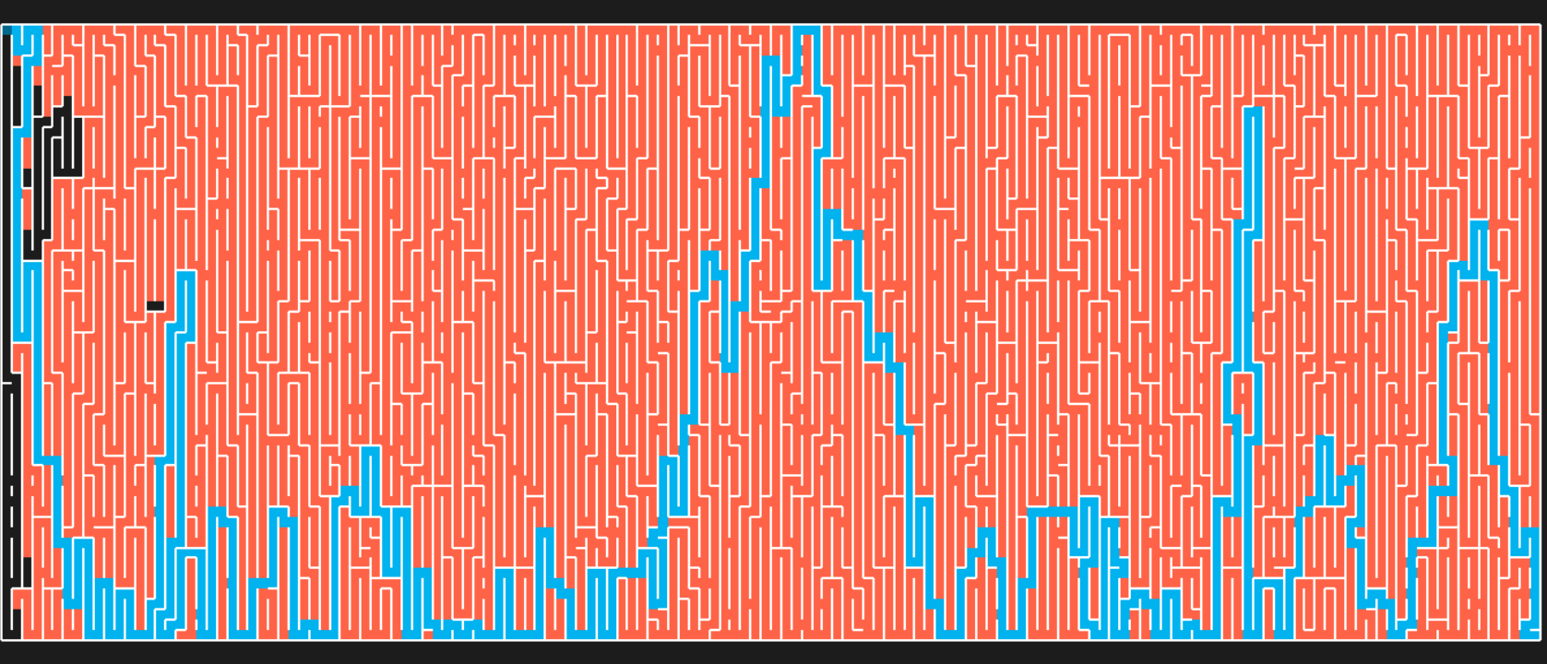
A* Search Algorithm using Manhattan Heuristic Function

Slide 2
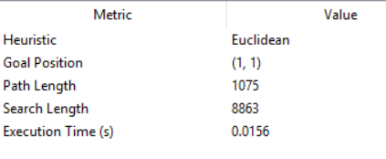
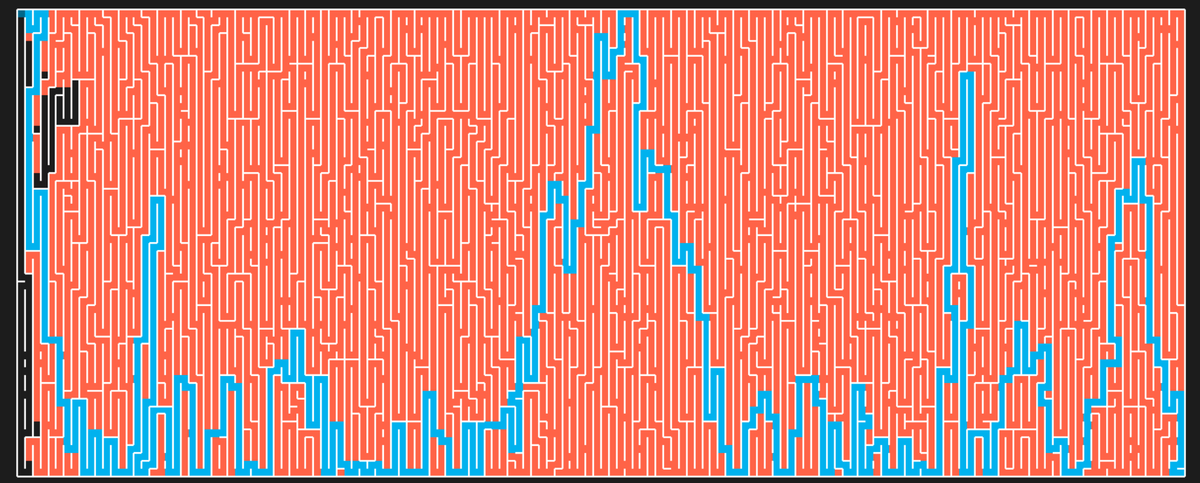
A* Search Algorithm using Euclidean Heuristic Function

Slide 3
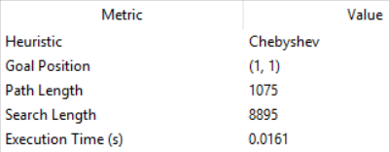
A* Search Algorithm using Chebyshev Heuristic Function

Slide 4
Greedy_BFS Algorithm using Manhattan Heuristic Function

Slide 5
Greedy_BFS Algorithm using Euclidean Heuristic Function

Slide 6
Greedy_BFS Algorithm using Chebyshev Heuristic Function

Slide 8
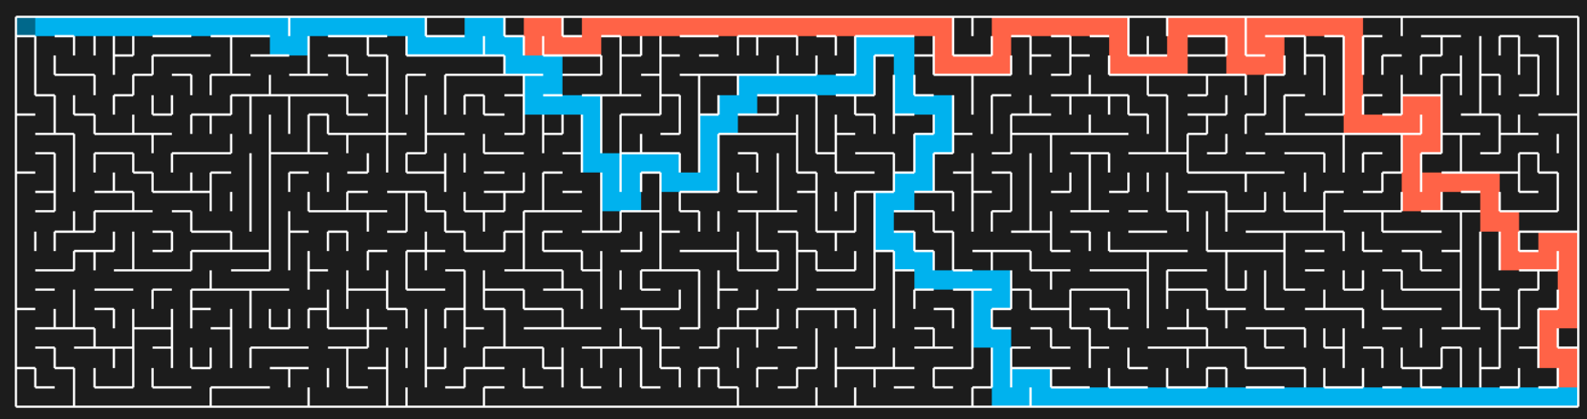
Weight | Heuristic | Path Length
(N,E,S,W)
(10,-10,-10,10) | Manhattan | 133
(10,-10,-10,10) | Euclidean | 133
(10,-10,-10,10) | Chebyshev | 133

Slide 9
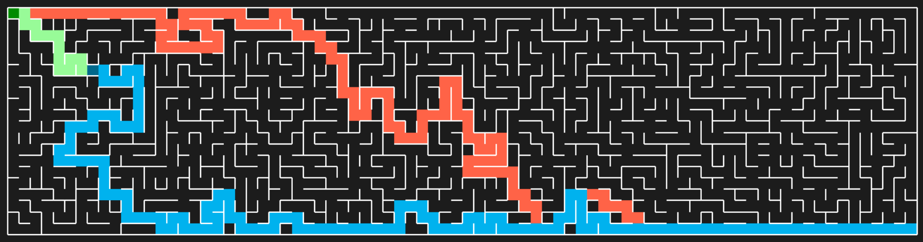
Weight | Heuristic | Path Length
(N,E,S,W)
(-10,10,10,-10) | Manhattan | 143
(-10,10,10,-10) | Euclidean | 147
(-10,10,10,-10) | Chebyshev | 147

Slide 10
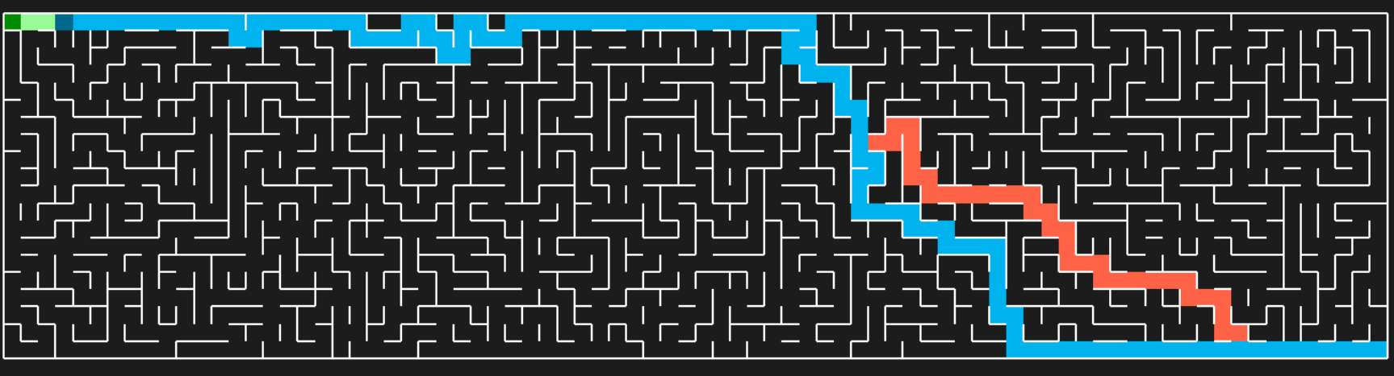
Weight | Heuristic | Path Length
(N,E,S,W)
(0,10,10,0) | Manhattan | 113
(0,10,10,0) | Euclidean | 113
(0,10,10,0) | Chebyshev | 113

Slide 11
Weight | Heuristic | Path Length
(N,E,S,W)
(0,-10,-10,0) | Manhattan | 133
(0,-10,-10,0) | Euclidean | 133
(0,-10,-10,0) | Chebyshev | 133
Not Applicable

Slide 12
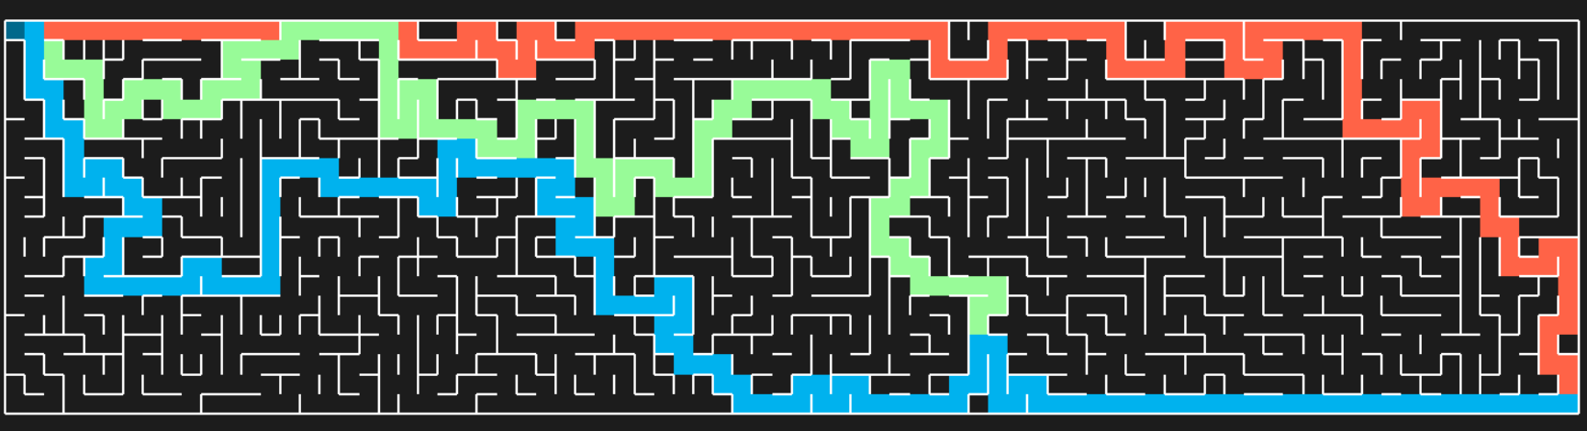
Weight | Heuristic | Path Length
(N,E,S,W)
(0,0,0,0) | Manhattan | 133
(0,0,0,0) | Euclidean | 153
(0,0,0,0) | Chebyshev | 147

Slide 13
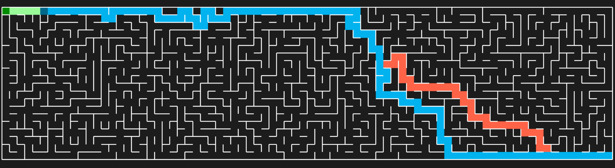
Weight | Heuristic | Path Length
(N,E,S,W)
(10,10,10,10) | Manhattan | 113
(10,10,10,10) | Euclidean | 113
(10,10,10,10) | Chebyshev | 113

Slide 14
Weight | Heuristic | Path Length
(N,E,S,W)
(-10,0,0,-10) | Manhattan | 133
(-10,0,0,-10) | Euclidean | 133
(-10,0,0,-10) | Chebyshev | 133
Not Applicable

Slide 15

Weight | Heuristic | Path Length
(N,E,S,W)
(10,0,0,10) | Manhattan | 133
(10,0,0,10) | Euclidean | 153
(10,0,0,10) | Chebyshev | 147

